Slide 1
Plasma Material Interactions
Daniel Andruczyk
Email contact: andruczy@Illinois.edu

Slide 2
Outline
Introduction 3
Basics of plasma material interactions 7
Low temperature plasma material interactions 28
High temperature plasma material interactions 50
Plasma surface diagnostics 74
Summary 84

Slide 3
Outline
Introduction 3
Basics of plasma material interactions 7
Low temperature plasma material interactions 28
High temperature plasma material interactions 50
Plasma surface diagnostics 74
Summary 84

Slide 4
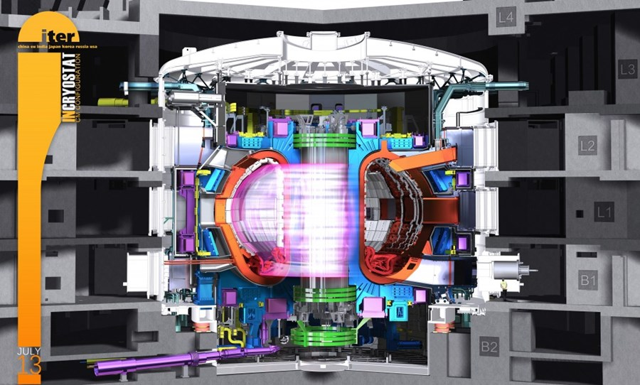
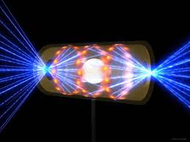
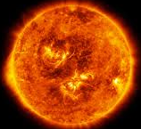
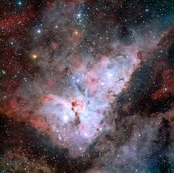






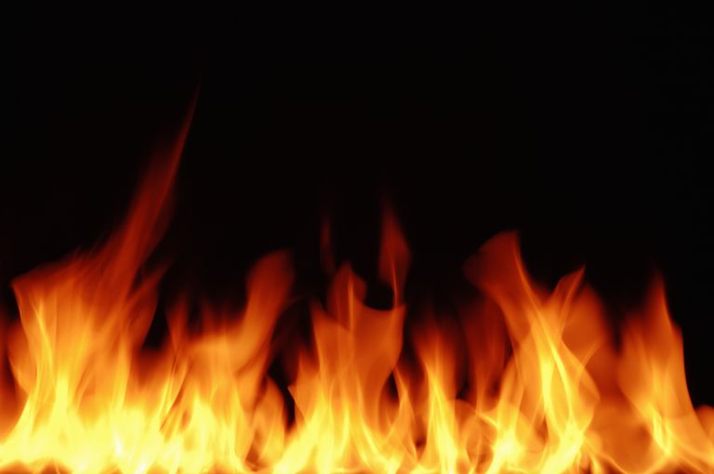
Temperature ( K )
Temperature ( eV )
10⁸
Magnetic
Confinement
Fusion
Inertial
Confinement
Fusion
10⁴
10⁷
10³
Solar Corona
Solar Core
10⁶
Nebula
10²
Neon Lights
Lightning
10⁵
10
Interstellar Space
Fluorescent
Lights
10⁴
Complex,
Strongly
Coupled
Plasmas
1
Auroras
Flames
10³
10^{–1}
10³
10⁶
10⁹
10¹²
10¹⁵
10¹⁸
10²¹
10²⁴
10²⁷
10³⁰
10³¹
Number Density ( Charged Particles m^{–3} )

Slide 5
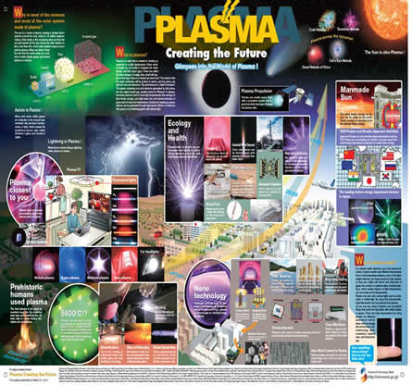
Plasmas have an impact everywhere in everyday life!

Slide 6
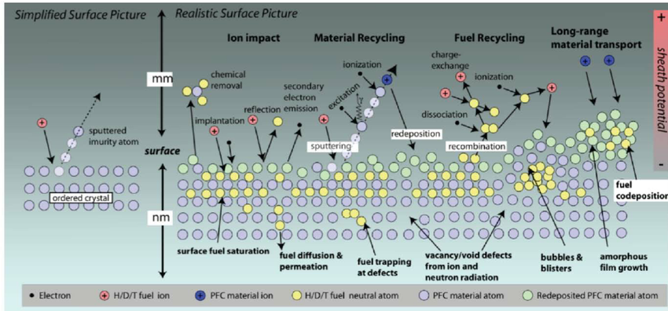
Plasma material interactions are extremely complex

Slide 7
Outline
Introduction 3
Basics of plasma material interactions 7
Low temperature plasma material interactions 28
High temperature plasma material interactions 50
Plasma surface diagnostics 74
Summary 84

Slide 8
Damage and modification production mechanisms
Ballistic damage
Displacement from collisions
Surface structures develop
No special role of surface in this mechanism.
Viscous flow
Local volume expansion
Adatom production on surface
Cavitation
High atomic numbers, low melting temperature
Micro-explosions
Cascade near surface
Pressure wave ruptures near surface
Adatom production on surface
Cavity production on surface
Surface vacancy production
Surface
Mechanism
Sub Surface
Energy deposited into material

Slide 9
Surface Science
What are the fundamental aspects of a surface that need to be considered?
Surface tension
Surface stress
Thermal vibration of atoms
Surface electro dynamics
Surface activated mechanisms
Surface diffusion
Structure and reconstruction of atoms
Surface defects
Adsorbed atoms (adatoms)
Surface vacancies
How does interaction with the plasma change the surface?

Slide 10
What PMI effects do we need to worry about?
Reflection
Implantation
Sputtering
Electron Emission

Slide 11
Surface interactions
Ion beam with an energy E_{i}
I
+
Elastic Effects
Inelastic Effects
Accelerated
by the field
Accelerated
by the field
Sputtered Particles
T⁰, T*, T^{n}
Negative Ions
UV/visible photons
T⁻, I⁻
X-rays
Reflected Particles
I⁰,I*
Secondary
Electrons
T⁺, I⁺
Positive ions are returned by the electric field
Implanted Particles
Target
0
I
Figure after G.M. McCracken, Rep. Prog Phys. 28, 241 (1975).

Slide 12
Reflection
Ions almost always reflect as neutrals.
Exception is reflection from “alkali” metals, such as lithium. (The last electron is so loosely bound the atom can be ionized by its last collision on the way out of the material).
Note you will never see a reflected ion because it can not escape the sheath.
Coefficients can be gotten from simulations e.g SRIM.
It is called backscattering.
A number of around 30% with the backscattered particles having around 30% of their energy is a good rule-of-thumb.
Clearly though mass difference is important.
Light on heavy always reflects.
Heavy on light does not.

Slide 13
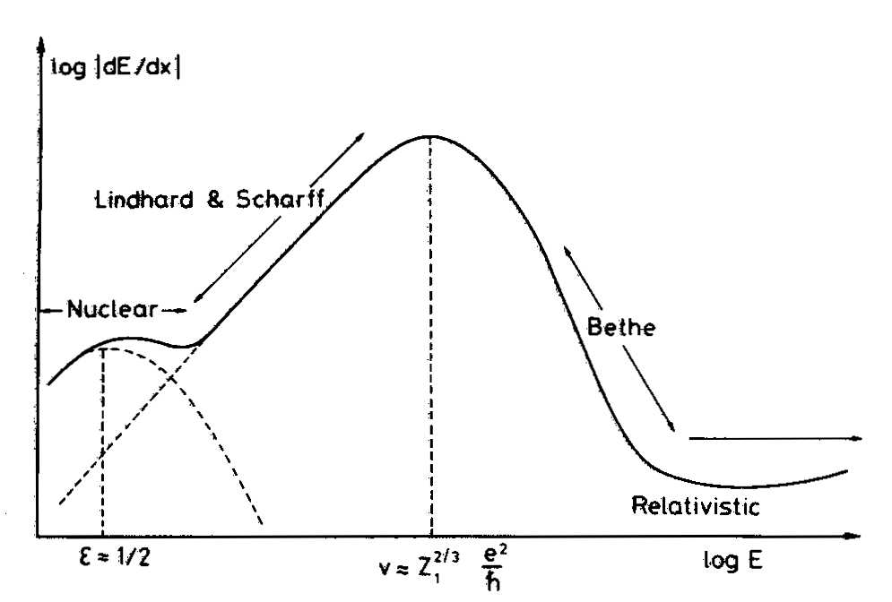
Implantation: Stopping cross-section
Nuclear vs. electronic stopping powers depend on incident particle energy
Transition depends on particle-material combination
Typical energies:
Below ~ 1-10-keV nuclear stopping energy loss is dominant
Losses due to electronic stopping more dominant for most particle target systems at high energies (e.g. > 10 keV)
Electronic losses mostly to energy loss via electron-phonon coupling (heat).

Slide 14
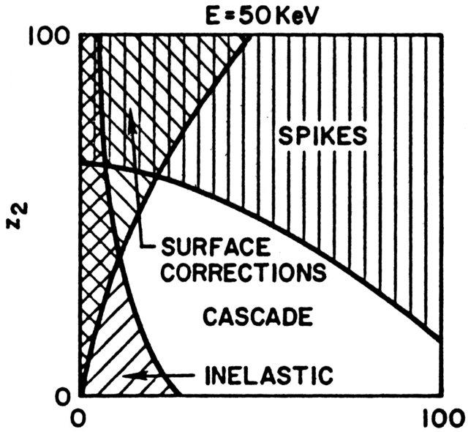
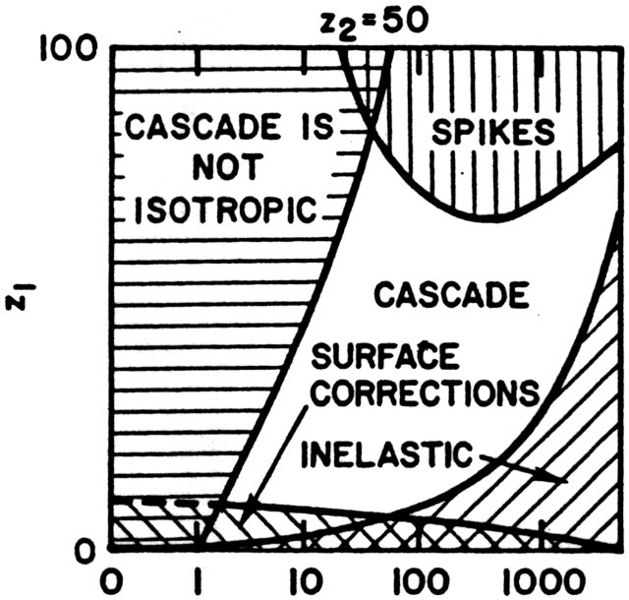
Fundamentals of sputtering
Target “Z”
Incident ion energy (keV)
Incident ion “Z”
The exact type of interaction depends on
Incident ion atomic number, “Z”
Target atomic number
Incident energy
For Argon on most metals in most sputtering devices, we are in the “non-isotropic cascade” regime.
From D. N. Ruzic, “Fundamentals of Sputtering”, in Plasma Handbook of Processing Technology, Ed. S.Rossnagel et. al., 1990

Slide 15
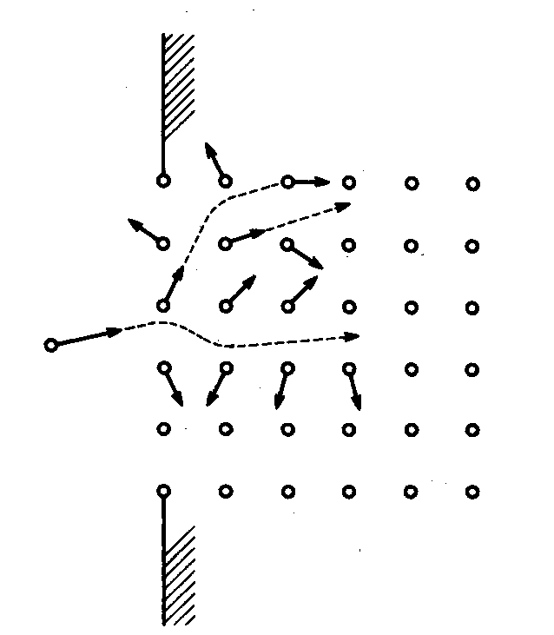
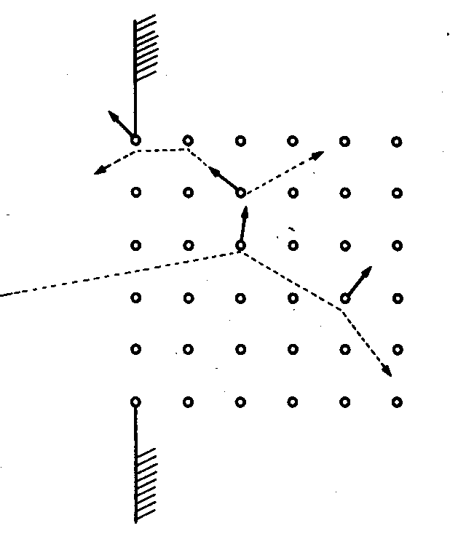
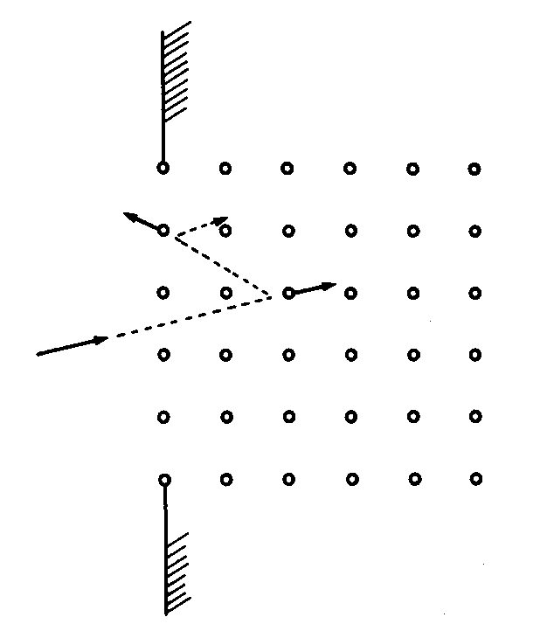
Non – isotropic collision cascade
Energy increasing (dependent on M_{i}/M_{t})
P.Sigmund, “Sputtering by ion bombardment: theoretical concepts”, in Sputtering by particle bombardment I, edited by R. Behrish, Springer-Verlag, 1981
Threshhold regime
recoils sputtered, but
no (limited) cascades
Linear cascade
a series of binary collisions
Spike regime
high density of recoils
Ions striking a surface interact with a number of atoms in a series collisions.
recoiled target atoms in turn collide with atom at rest generating a collision cascade.
The initial ion energy and momentum are distributed to among the target recoil atoms.
When E_{i} > 1 keV, the cascade is “linear”, i.e. approximated by a series of binary collisions in a stationary matrix.

Slide 16
Sputtering
1950’s and 60’s sputtering first described
P. Sigmund, Phys Rev. 184 383 (1969)
Assumptions in sputter theory
Linear transport
Lattice is random
Collision cascades are isotropic
Stopping power described by elastic nuclear collisions.
Sputter yield
Material factor
Energy density deposited per ion
Geometric Factor
Stopping power at E₀
Ejection Probability

Slide 17
Assumption in classical sputtering theory
If these assumptions hold, then one can simplify the sputter yield expression
Linear transport theory (i.e. all collisions are between moving projectiles
and lattice atoms at rest; each collision is an independent binary event)
Lattice is random
Collision cascade is isotropic
Stopping power described by elastic nuclear collisions
Target Density
Surface Binding Energy
Constant ~ 15.6

Slide 18
Sputtering Yield (γ)
Sputtering begins at an energy threshold
Increases rapidly.
As the energy increases the curve levels off.
4
Target
Sputtering
with Argon
Ag
3
Cu
2
Sputtering Yield (Atoms/ion)
Co
1
Ti
0
C
0
100
200
300
400
500
600
Ion Energy (eV)
Data from R.Y. Stuart and G.K. Wehner, J. Appl. Phys. 33, 2351 (1962); D. Rosenberg and G.K. Wehner, J. Appl. Phycs. 33, 1842 (1962); and R. Behrisch, Exakt. Naturw. 35, 295 (1964).

Slide 19
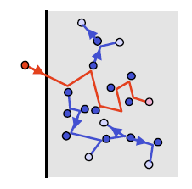
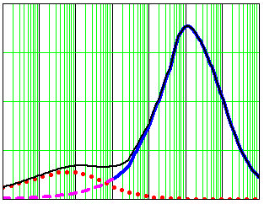
Sputtering and recoil displacement
The sputtering yield is proportional to the number of displaced or recoil atoms
Energy density deposited per ion, F_{D}(E), depends on nuclear stopping cross section at low energies, S_{n}(E)
Nuclear stopping is the average energy loss which results from elastic collisions with target atoms
The nuclear stopping power or nuclear energy-loss rate is the energy lost by a moving particle due to elastic collisions per unit length travelled in the target
2
1.5
1
0.5
0
Stopping Cross section
(10⁻¹² eVcm²)
Ge → Si
H on Ni case: Thick solid blue line is electronic energy loss, dotted (red) is nuclear energy loss and thin black line is total energy loss (compared to Ge on Si)
1 10² 10⁴ 10⁶
Energy (keV)

Slide 20
Sputtering Threshold
The sputtering threshold, U_{th}, is approximately the surface binding energy, E_{sbe}, divided by the maximum energy transfer function (γ)
m_{i}, is the incident mass, m_{t}, is the target mass. Note that if, m_{i} = m_{t}, then, γ = 1. For Ar on Si it is 0.969.
Surface binding energies are 3 to 7 eV.
Note though, while sputtering physically can happen at threshold it is very, very small.

Slide 21
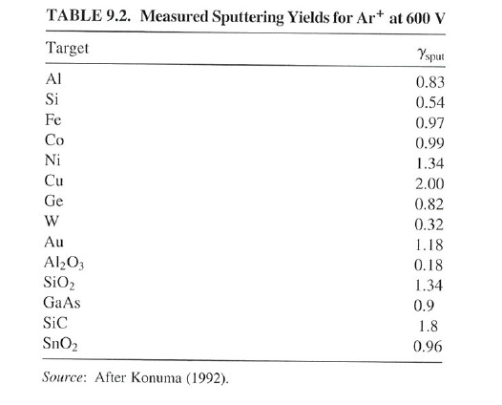
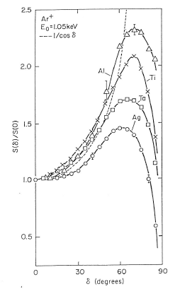
Angular dependence for incident ion
For most sputtering devices, the angle is zero, normal to the surface. Higher angle lets one “get underneath”. Too high of angle means incident particle may just skip off the surface
Note
Copper (Cu) is easy to sputter.
Tungsten (W) is not easy to sputter.
Alumina (Al₂O₃) is really tough

Slide 22
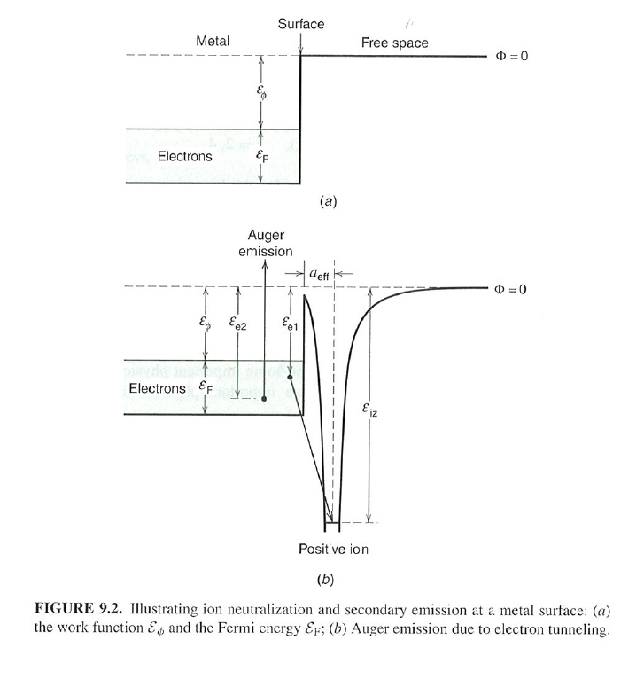
Potential electron emission
As an ion approaches a surface, it becomes energetically favorable for an electron to tunnel over to the ion and neutralize it.
THIS ALWAYS HAPPENS
– an ion never actually hits a surface
Then, that extra energy can manifest itself in a number of ways. If the ionization potential is greater than 2 times the work function of the material, an electron from the surface to be emitted. This is “potential emission”.
Ion neutralization and secondary emission at a metal surface: (a) the work function E₀ and the Fermi energy E_{F}: (b) Auger emission due to electron tunnelling.

Slide 23
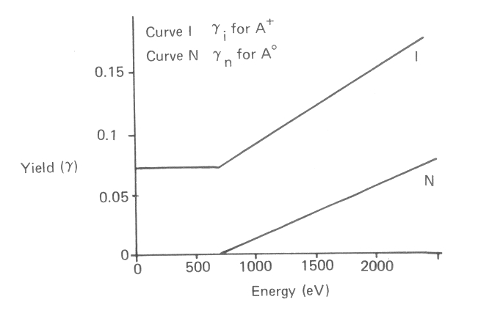
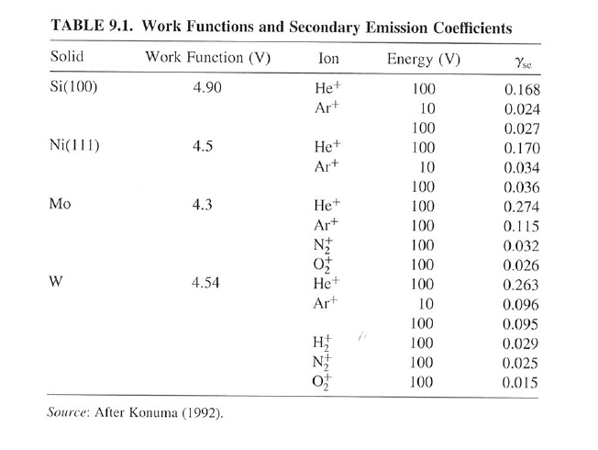
Ion induced secondary electron emission
Higher energy ions or neutrals can liberate electrons through “kinetic emission” – basically impact ionizing the solid.
He⁺ is always higher since ionization potential is higher.
Note small effect of kinetic emission in energy range in fusion plasmas.
Surfaces with low work functions (e.g. alkali metals) will emit more electrons.

Slide 24
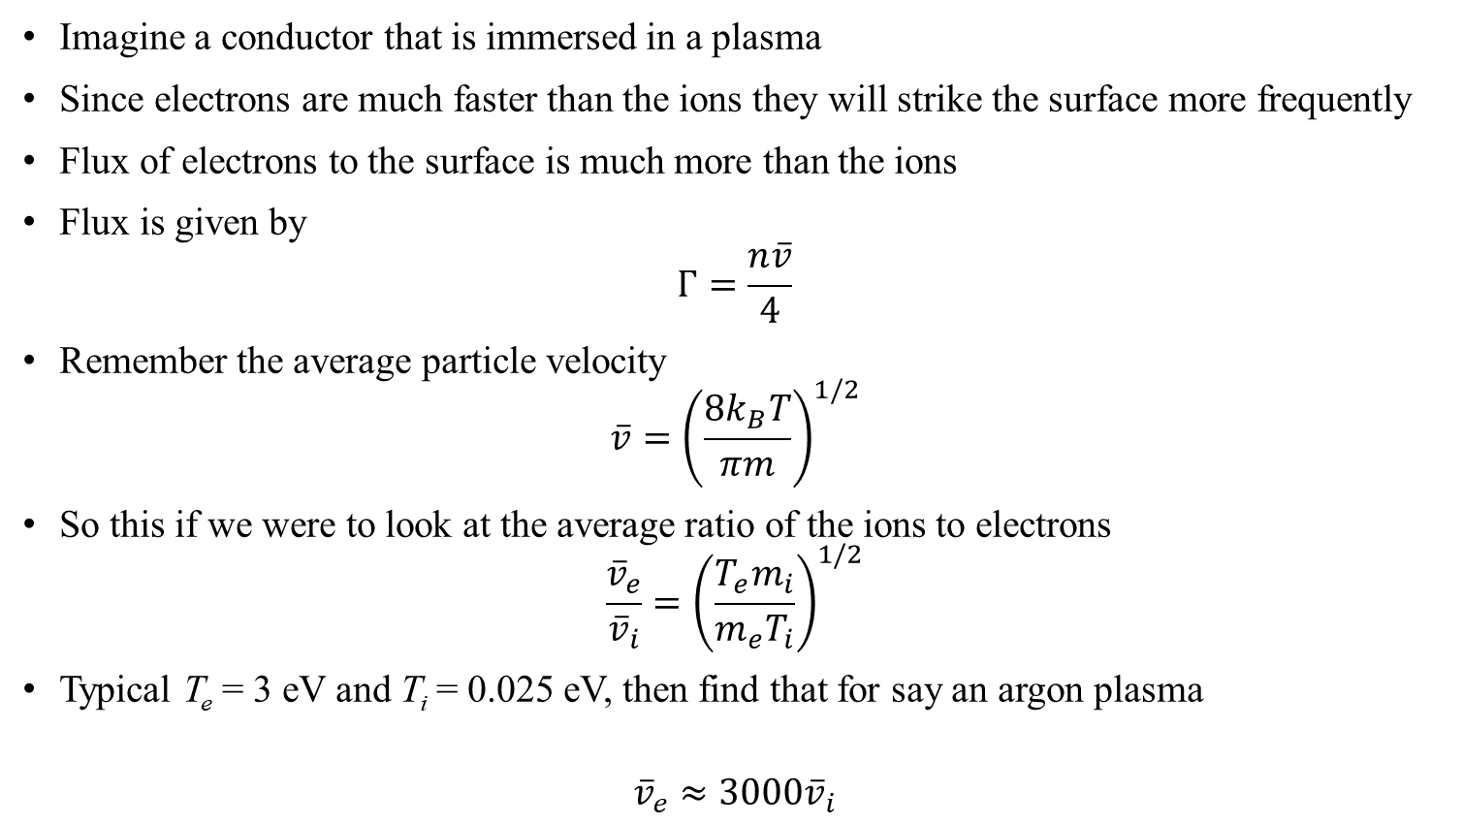
Need to talk about the sheath
Imagine a conductor that is immersed in a plasma
Since electrons are much faster than the ions they will strike the surface more frequently
Flux of electrons to the surface is much more than the ions
Flux is given by
$$Γ=\frac{n\overline{v}}{4}$$
Remember the average particle velocity
$$\overline{v}={\left(\frac{8k_{B}T}{πm}\right)}^{1/2}$$
So this if we were to look at the average ratio of the ions to electrons
$$\frac{{\overline{v}}_{e}}{{\overline{v}}_{i}}={\left(\frac{T_{e}m_{i}}{m_{e}T_{i}}\right)}^{1/2}$$
Typical T_{e} = 3 eV and T_{i} = 0.025 eV, then find that for say an argon plasma
$${\overline{v}}_{e}≈3000{\overline{v}}_{i}$$

Slide 25
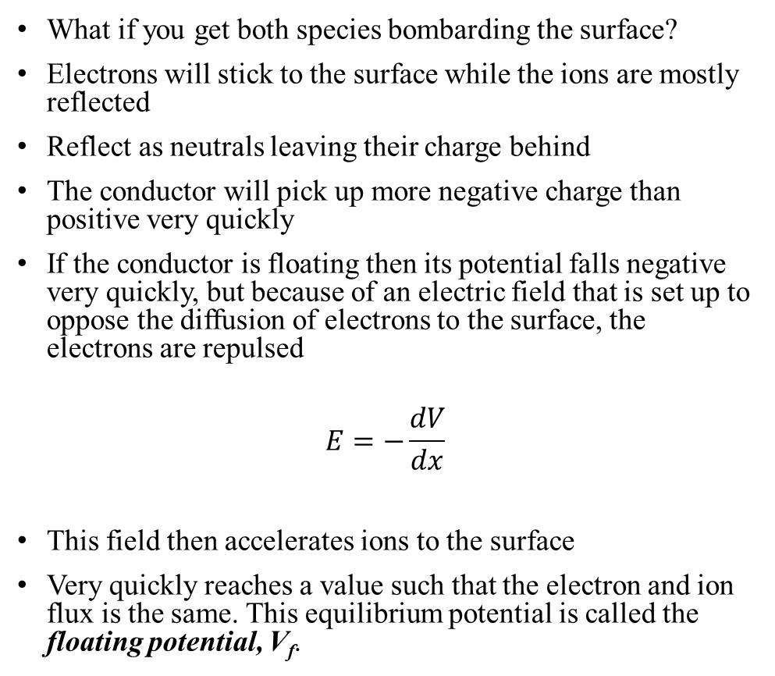
Acceleration of ions to the surface
What if you get both species bombarding the surface?
Electrons will stick to the surface while the ions are mostly reflected
Reflect as neutrals leaving their charge behind
The conductor will pick up more negative charge than positive very quickly
If the conductor is floating then its potential falls negative very quickly, but because of an electric field that is set up to oppose the diffusion of electrons to the surface, the electrons are repulsed
$$E=−\frac{dV}{dx}$$
This field then accelerates ions to the surface
Very quickly reaches a value such that the electron and ion flux is the same. This equilibrium potential is called the floating potential, V_{f}.
Plasma
Pre - sheath
Sheath
V_{P}
V_{f}
Distance to surface
Δx

Slide 26
The plasma sheath
Typically any conductor immersed inside a plasma will sit at the floating potential
Another way to think about it, V_{f}, is the voltage when the current, I = 0 A
Typically the plasma is only disturbed locally at the conductor surface and does not influence the rest of the plasma
The region of the plasma, that is disturbed around the probe is called the plasma sheath
Electrons are repelled in this region. The ones with the lowest energy are repelled while the ones with highest energy can still get through
Plasma
Pre - sheath
Sheath
V_{P}
V_{f}
Distance to surface
Δx

Slide 27
Outline
Introduction 3
Basics of plasma material interactions 7
Low temperature plasma material interactions 28
High temperature plasma material interactions 50
Plasma surface diagnostics 74
Summary 84

Slide 28
Low temperature plasma material interactions
R.F. Heating Source
CF₃ F O₂ SiF CF₃⁺ O– CO e– SiF₄ CF₂ etc…
CF₄ / O₂
PLASMA
Gas Inlet
Pump
Si0₂
Si

Slide 29
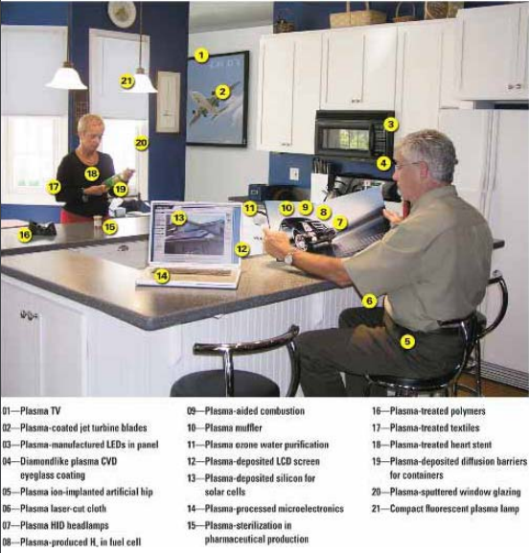
Plasmas (and the material interactions) influence our lives everyday

Slide 30
Applications of low temperature plasmas and PMI
Plasmas are used in a wide variety of places
Semiconductor industry
Surface modification
Treat emission and waste before entering the environment
The plasma is a source of ions
What is needed by industry?
Simple and compact plasma devices
Processing at high rates
Processing at high efficiency
Processing to be uniform over a large area
Can control several parameters to produce the best type of plasma
Size and shape of plasma
Gas mixture
Voltage
Current
Magnetic field
Frequency
These determine the ion and electron density and temperatures, ion fluxes and energies
There will be atomic and molecular process that need to be understood as well, within the plasma and the surface

Slide 31
Fabrication with plasma
So lets look at micro-fabrication, in particular the semi conductor industry
In general we want to make a pattern of some kind.
The method used is to have
a. Lay down a substrate
b. Deposit insulating etch material
c. Deposit masking material with pattern
d. Etch exposed material away
e. Remove masking material
f. Lay down conducting material
g. Sputter away unwanted conductor
h. Repeat process to get the desired pattern
(a)
(e)
(b)
(f)
(c)
(g)
(d)
(h)

Slide 32
Plasma deposition
Different types of plasmas can be used to do all these processes
Lets look at some examples of plasmas used for deposition.
There are in fact many different ways to do plasma deposition.
Will cover some but not all methods here.
So imagine there is a thin film that needs to be deposited onto a surface (substrate)
Can do this via
Evaporation
Using a plasma to sputter material onto the surface
Use a plasma to react with a material and deposit it on a surface
Can use chemical vapor to deposit material on a surface
Plasma vapor deposition where the plasma is able to enhance the chemical deposition
Plasma
Chemical
Evaporation
Sputtering
Reactive sputtering
Chemical Vapor deposition
Low pressure CVD
Plasma enhanced CVD
film

Slide 33
Plasma deposition
Target is the source of coating material for the substrate
DC sputtering: metals , the target is the cathode
RF sputtering: non conducting materials
Ion beam sputtering
Reactive sputtering, TiN for wear resistance, Ti + N₂ gas
The substrate may be biased so ion bombardment modifies the film being grown
Plasma assisted CVD, electron bombardment of atoms and molecules in the plasma volume
Excitation and dissociation of species
Produce variety of chemically reactive species with very different properties from the parent gas
Lower temperatures required
target
argon
+
film
substrate
N₂
TiN
Ti

Slide 34
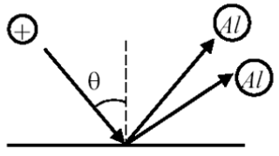
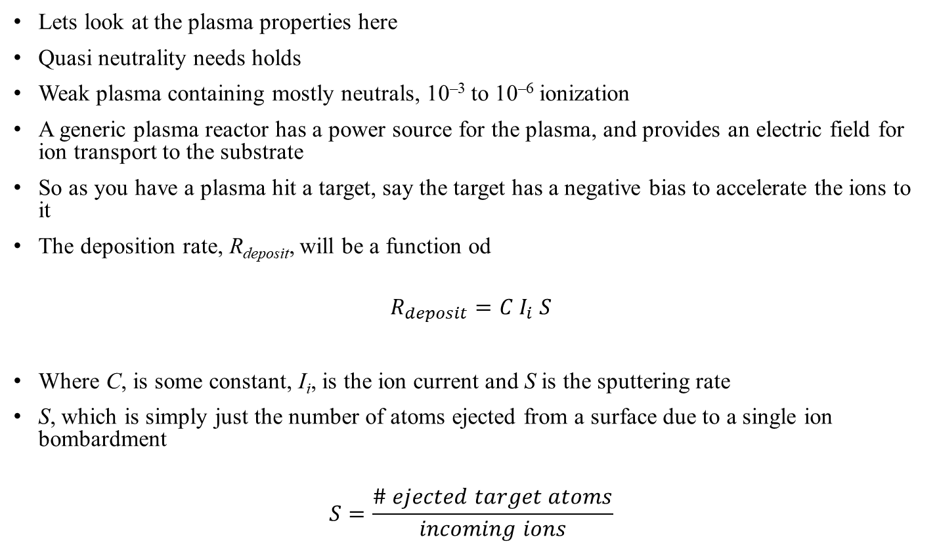
Plasma deposition
Lets look at the plasma properties here
Quasi neutrality needs holds
Weak plasma containing mostly neutrals, 10^{–3} to 10^{–6} ionization
A generic plasma reactor has a power source for the plasma, and provides an electric field for ion transport to the substrate
So as you have a plasma hit a target, say the target has a negative bias to accelerate the ions to it
The deposition rate, R_{deposit}, will be a function od
$$R_{deposit}=C I_{i} S$$
Where C, is some constant, I_{i}, is the ion current and S is the sputtering rate
S, which is simply just the number of atoms ejected from a surface due to a single ion bombardment
$$S=\frac{\# ejected target atoms}{incoming ions}$$
Power source
Plasma
E–field
substrate

Slide 35

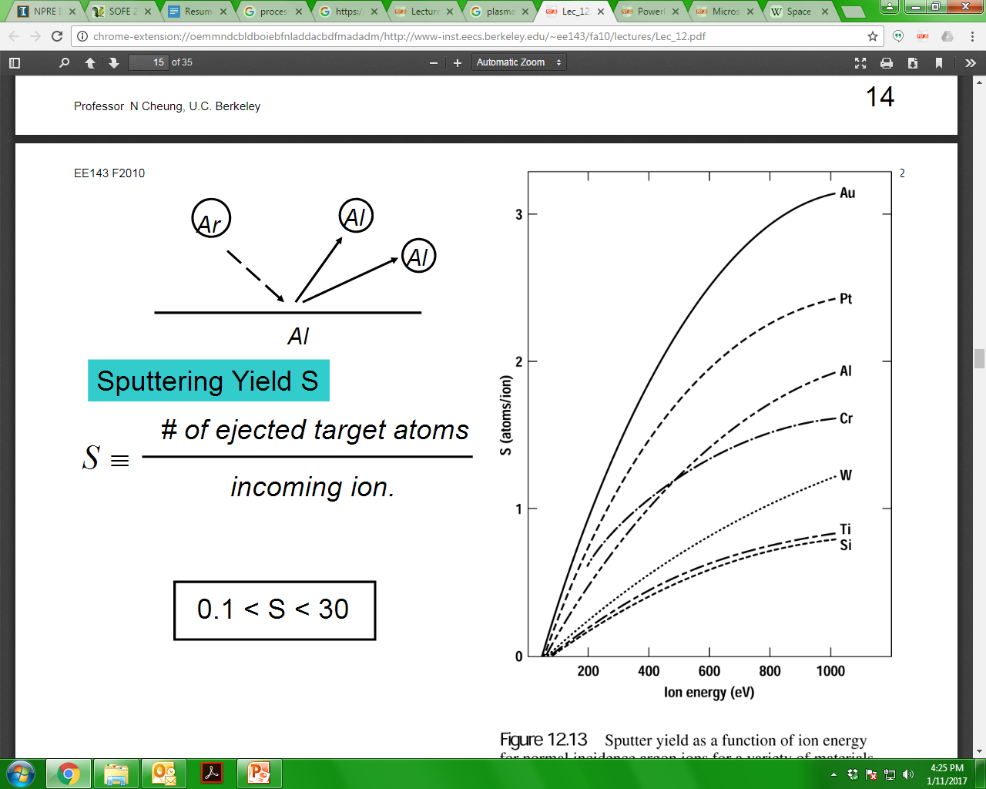
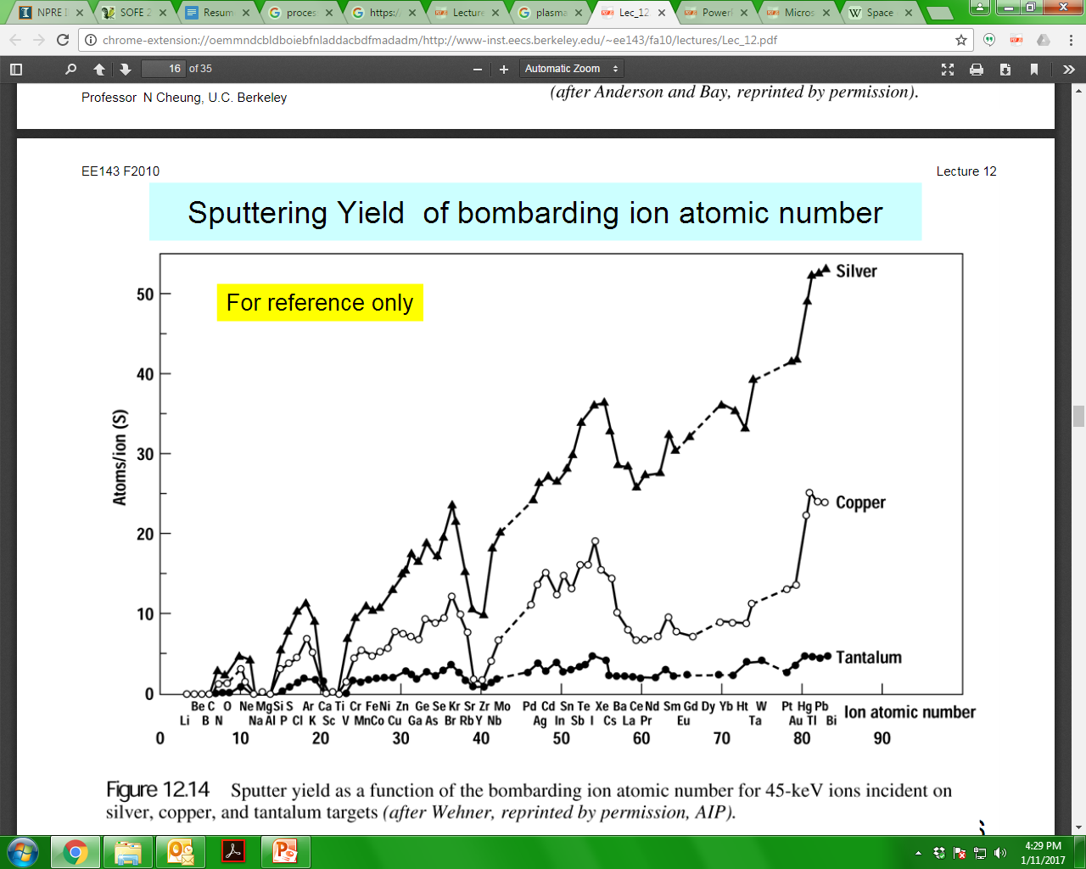
The sputtering rate is different for different surfaces
Units: atoms/ion
Dependent on ion energy
Dependent on angle incident on surface
0.1 < S < 30

Slide 36
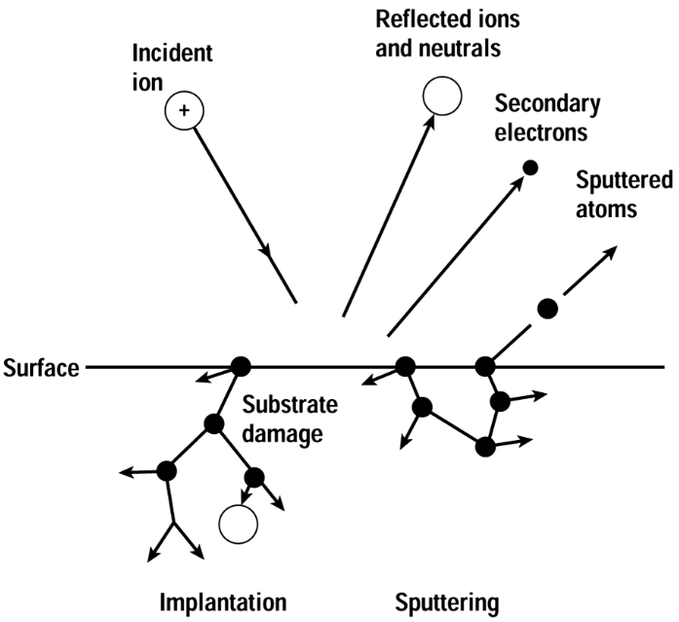
Substrate is also exposed to the plasma
Typical gas pressure is 1 – 10 mtorr
What is this in Pa?
The ejected atoms from the target then land onto the substrate and form a film
But this is not necessarily all hunk dory
What can happen to the substrate surface in this process?
Remember that it is also exposed to the plasma and now there are energetic target ions, neutrals and radicals that are hitting it
Implantation: The incoming ion/atom is able to implant itself into the substrate, thus over time a layer gets built up
Sputtering: just like with the target, if there is enough energy, rather than implantation there will be surface ejection, this leads to surface damage and non-uniformity
Secondary electrons can also be emitted as well as the incoming ions are neutralized at the surface and get “reflected back” at the temperature of the surface

Slide 37
Sputtering of multi-compound targets will yield a film that is made up of multi-compounds
target
Target is made up of elements A and B
Since
S_{A} ≠ S_{B}
then target surface will acquire a A_{x}B_{y} at steady state and so the film will be deposited with A_{x}B_{y}
Reactive sputtering where the ejected ions from the target react with the plasma gas itself to form a new compound that coats the substrate
Example is titanium nitride, TiN
Sputter a Ti target with N₂ plasma
Ti, N₂⁺ will then react to form the Ti
This is a beautiful golden color, often used to coat drill bits for increased wear resistance
ion
Γ_{A}
Γ_{B}
target
Ti target
N₂ plasma
Ti, N₂⁺
TiN
substrate

Slide 38
What if we want to remove material?
This is called plasma etching
Etching is the removal of “unwanted” material off a surface
Lets look at something like etching away silicon (Si) to make patterns in micro chips
CF₄ gas is used to do the etching. By itself the CF4 will not etch but if the bonds can be broken through the generation of a plasma now the free F atoms can react with the Si
Creates a volatile gas SiF₄ and can be pumped away.
However what happens to the C? It can be left on the surface thus “protecting” any further Si to be etched away
Solution: have a bit of O₂ in the plasma and this will react with the C to form CO and CO₂ and can be pumped away
Start with a silicon etch substrate with a mask to protect any area needed
mask
Si etch material
Plasma
Generate a plasma with volatile gas such as CF₄. This will etch away the Si by forming SiF₄
The SiF₄ gas is pumped away, however, the remaining carbon is left behind on the surface
By having some O₂ in the plasma, will react with the carbon, forming CO, CO₂ and pump away leaving a clean surface

Slide 39
Types of plasma sources – DC Plasma (DCP)
There are many different types of plasma sources that can be used to do plasma processing.
Advantages and disadvantages
Simplest type is the direct current (DC) plasma source
This simply has two electrodes where a potential is applied.
The E – field that is generated accelerates and stray electrons and if sufficient voltage will cause enough cascading break downs
Advantages
simple to set up, not very complicated to use
quick turn around
Disadvantages:
low density
low temperature
high pressure
Lots stray contamination
Ballast resistor
upper electrode
PLASMA
d.c
Power supply
substrate
lower electrode
Grounded vacuum vessel

Slide 40
DC magnetron (DCMP) plasma
Capable of high current densities and fast processing
A magnetic field (0.02 T) is able to confine secondary electrons
Bright ring that sits above the cathode
The ions are still able to reach the cathode and bombard it
The material on the cathode can be just about anything
Metallic
Oxides
Insulating material
Advantages
Almost any metallic target material can be sputtered without decomposition
Non-conductive materials can be sputtered
Oxide coatings can be sputtered (reactive sputtering)
Excellent layer uniformity
Very smooth sputtered coatings (no droplets)
high flexibility of sputtering equipment design
Disadvantages
Lower plasma density (~5%)
adhesion of coatings is lower
density of the sputtered layers may be lower
anode
substrate
Power supply
Magnetic field
cathode
S
N
S
Permanent magnets

Slide 41
Capacitively couples plasma (CCP)
Under applied r.f. voltage the plasma sheath boundary oscillated up and down while the bulk plasma remains uniform
Low pressure discharge can provide high ion energies for etching
High pressure discharge low ion energies for deposition
Heating mechanism, ohmic heating
Ohmic current is capacitively coupled across sheath
Since the sheaths are oscillating the electron velocities are changed over 1 period
Advantages
Simple construction
No B – fields required
Disadvantages
Low Ion flux
high ion energy
Surface damage likely
Geometry sensitive
Typical Frequency is f = 13.56 MHz
Blocking capacitor
Powered electrode
PLASMA
~
r.f
13.56 MHz
substrate
Grounded electrode
Grounded vacuum vessel

Slide 42
Inductively coupled plasma (ICP)
r.f
13.56 MHz
Think of a transformer, there is a coil that is the primary and the plasma is the secondary
The plasma is generated within the coils, again think of the fact that there are stray electrons that a plasma will ignite
Coils need to be shielded from the plasma by an insulator
Glass
Ceramic
Bias on the substrate will form an electric field between plasma and substrate
Accelerate ions in
Advantages
Ions energy can be independently controlled
Ion energies much less, less surface damage
Disadvantages
Tend to be large machines, cooling and pumping an issue
Non uniform density profile
Matching network
~
Grounded vacuum vessel
PLASMA
Coils
substrate
Coild shield from plasma
Biased electrode
Bias
Power supply

Slide 43
Vacuum Arc Plasma (VAP)
This is a very particular type of discharge that uses a low pressure arc to create the plasma
Neutral particles are formed so a linear device is not desirable
Substrate damage
contamination
Use a magnetic filter to transport ions (and electrons)
¼ tokamak essentially
Advantages
Fully ionized plasma
High deposition rate
Low substrate temperature
Disadvantages
Formation of macro-particles
Contamination
Slightly more complicated design
Magnetic field is used to filter the neutral particles
substrate
Neutral and macro-particles
Charged particles
Magnetic coils
arc
Anode
trigger
Cathode
Cathode spot

Slide 44
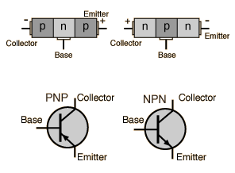
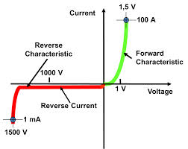
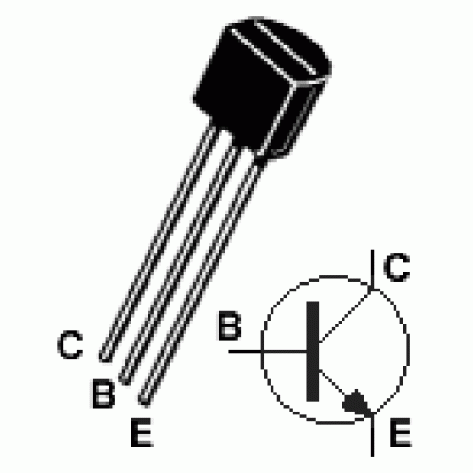
The Transistor
No voltage to the “base”, and no current flows from the “emitter” to the “collector”. It is OFF. Value is “0”
Add a small voltage to the “base”, and a large current can flow. It is ON. Value is “1”

Slide 45
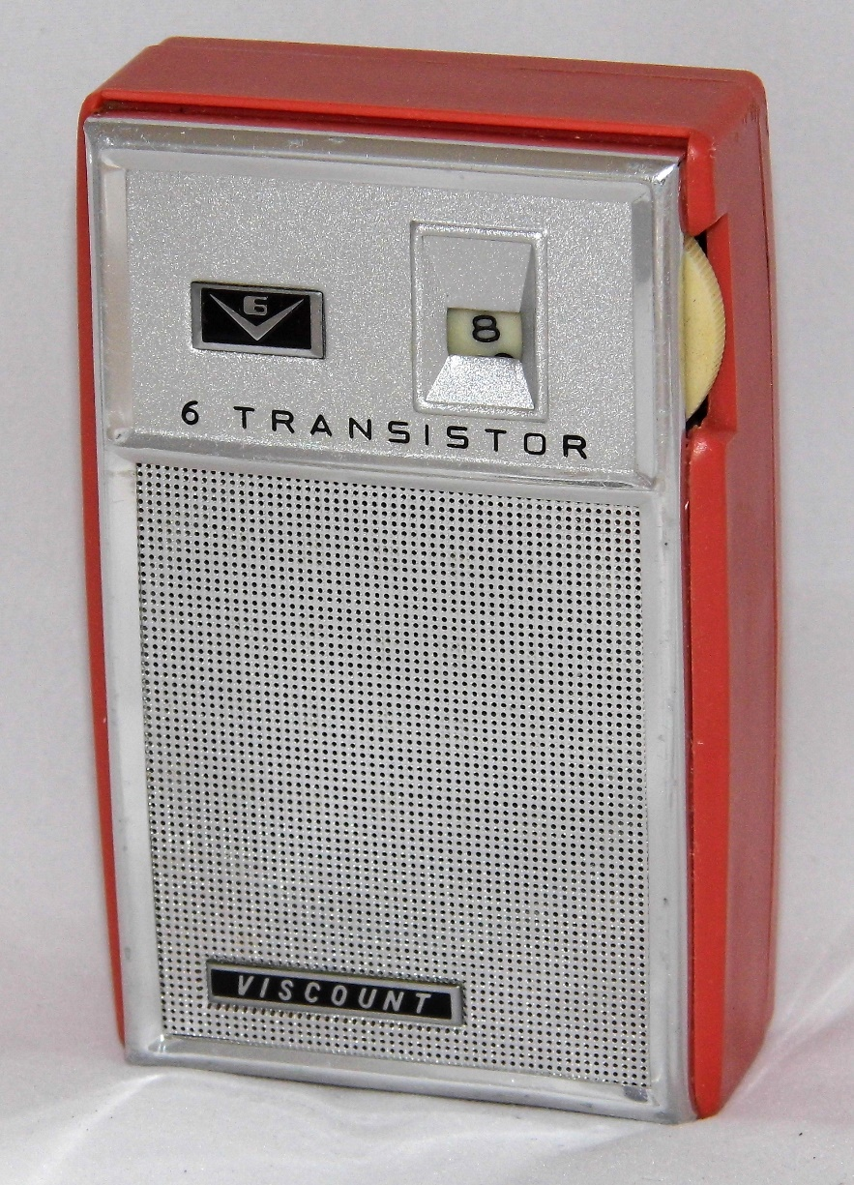
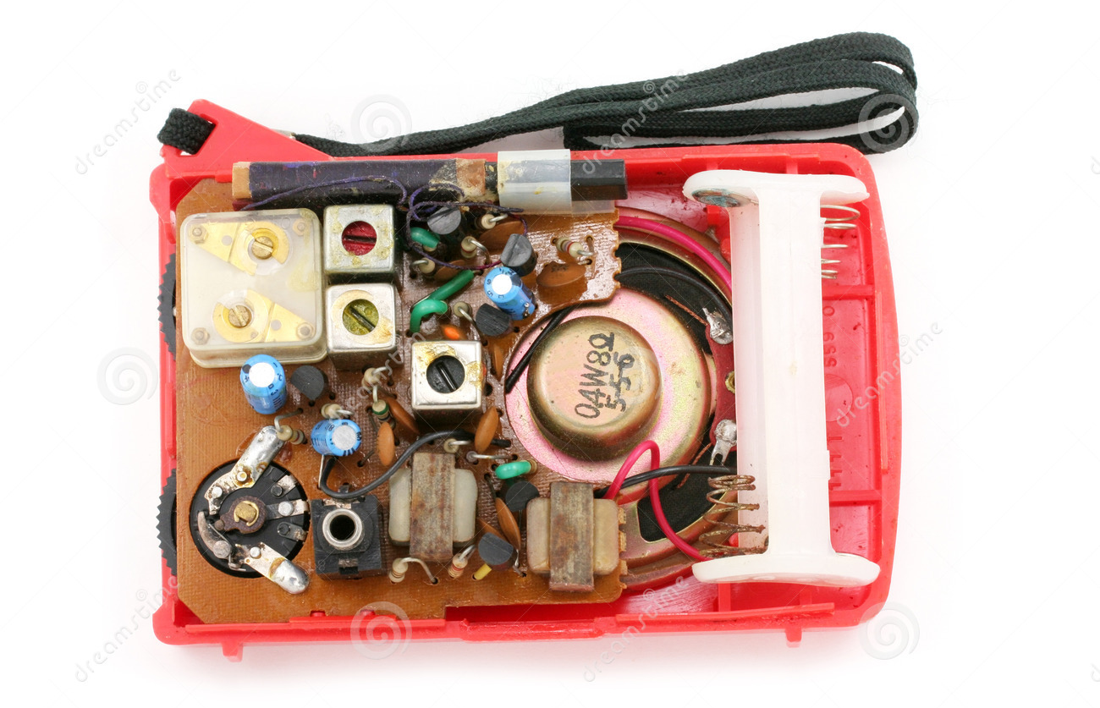
Radios used to only have a few transistors

Slide 46
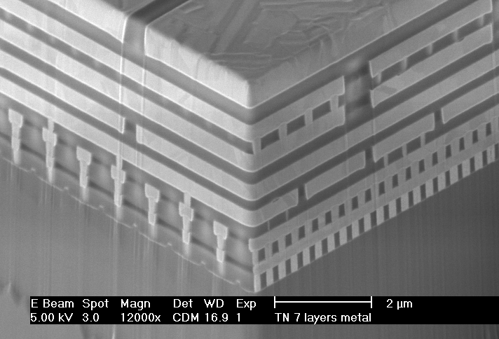
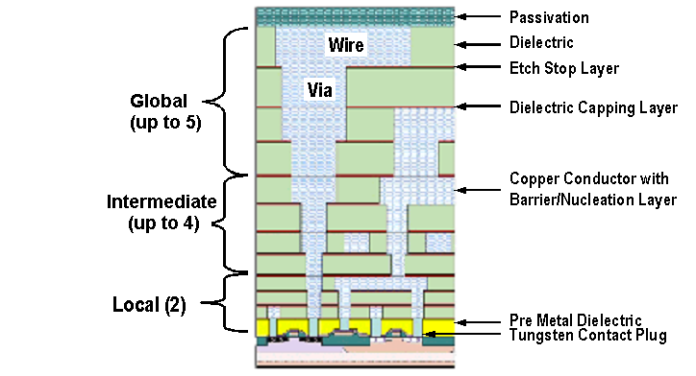
50 years later, look how far we have come!
Here is the N-P-N transistor
SEM cross-section, courtesy of AMD
layout, courtesy of International Sematech

Slide 47
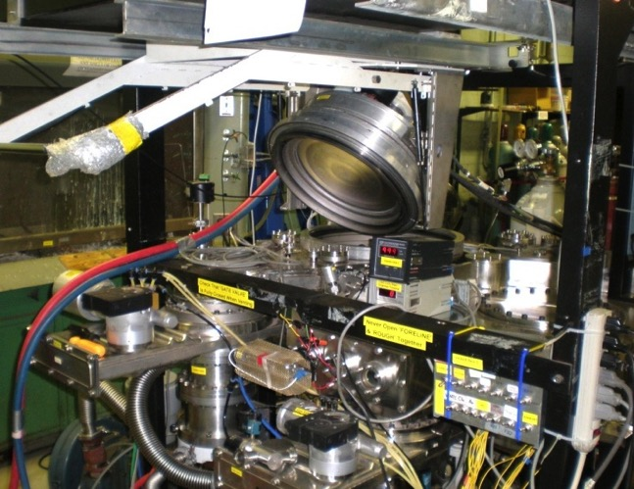
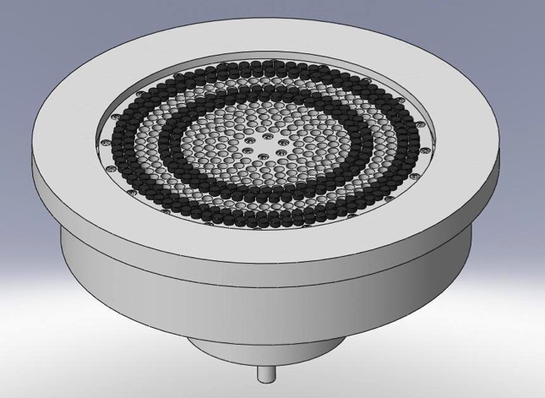
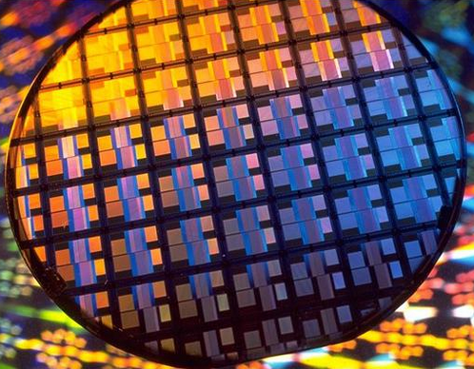
With the different plasma techniques now have millions of transistors on a single chip.
Spin Coating
Evaporation
Physical Vapor Deposition (PVD)
Chemical Vapor Deposition (CVD)
Plasma-Enhanced CVD (PECVD)
Atomic Layer Deposition (ALD)
Each technique has particular uses depending on size of feature and type of material

Slide 48
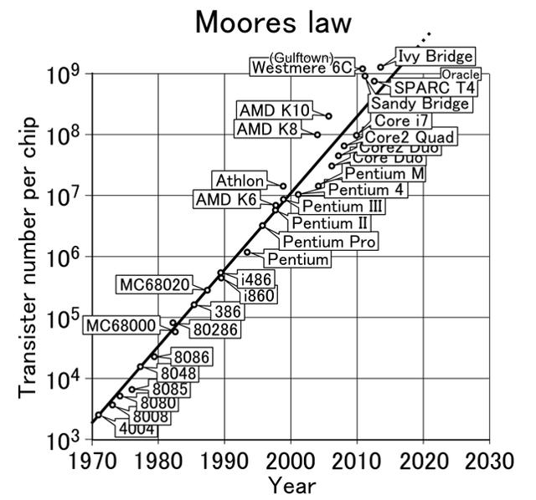
Moore’s law has pushed chip technology to its physical limits
Moore’s Law: The cost effective number of transistors that can be placed on an integrated circuit will double every two years.
Emphasis is on cost effective implementation, because making a higher transistor count does no good if no one can afford to buy the devices!

Slide 49
Outline
Introduction 3
Basics of plasma material interactions 7
Low temperature plasma material interactions 28
High temperature plasma material interactions 50
Plasma surface diagnostics 74
Summary 84

Slide 50
Fusion reactions – how does it impact plasmas
¹H
¹H
¹H
¹H
³H
²H
ν
ν
²H
²H
¹H
¹H
γ
γ
³He
³He
Proton
Neutron
Positron
Neutrino
Gamma Ray
¹H
¹H
Total Energy 17.6 MeV
ν
n
⁴He
γ
14.1 MeV
3.5 MeV
⁴He

Slide 51
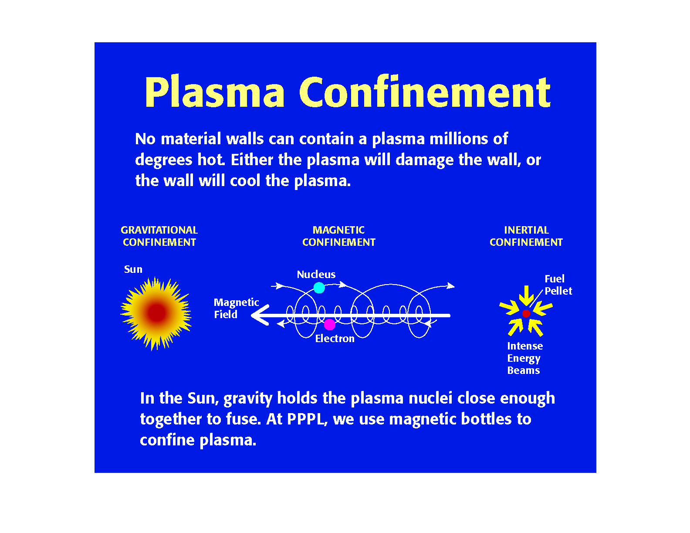
Confining a hot fusion plasma
Requires large
amounts of mass!
Confines the plasma in the direction across the magnetic field
Energy and defense
relevant

Slide 52
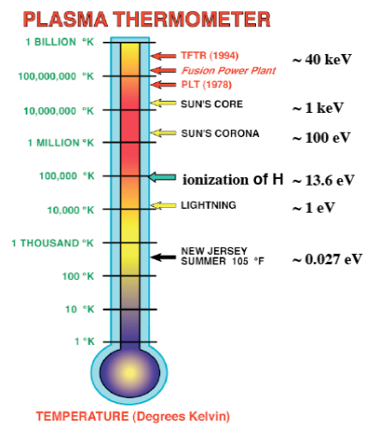
Challenge for fusion: Keeping the core hot and the plasma facing components (PFC) cold
Solid material limits
1 eV ~ 11,600 K

Slide 53
Complex behavior of materials and plasmas
Incident high energy ions and neutral will have a significant impact on the reactor surface
Damage
Displacement of atoms within the lattice structure of the materials
Leads to embrittlement
Surface structure formation
Fuzz
Blisters and bubbles
Fuel retention within the structure
Recycling
Cold hydrogenic species
Impurity atoms
Secondary electron emission
other
Plasma
T_{e}(a,t)
T_{i}(a,t)
n_{e}(a,t)
n_{i}(a,t)
P(a,t)
β(a,t)
Ions
First Wall
Impurity removal
Impurities
Fuel Retention
Neutrals
Heat Removal
Cold H₂
Impurities
Other

Slide 54
Minimization and control of impurities in the plasma
There is a maximum level of impurity allowed inside a fusion reactor
Tolerances for High-z are much stricter than for low Z
Anything the plasma touches will almost most definitely end up the fusion reactor and plasma
So as low-Z as possible is desired

Slide 55
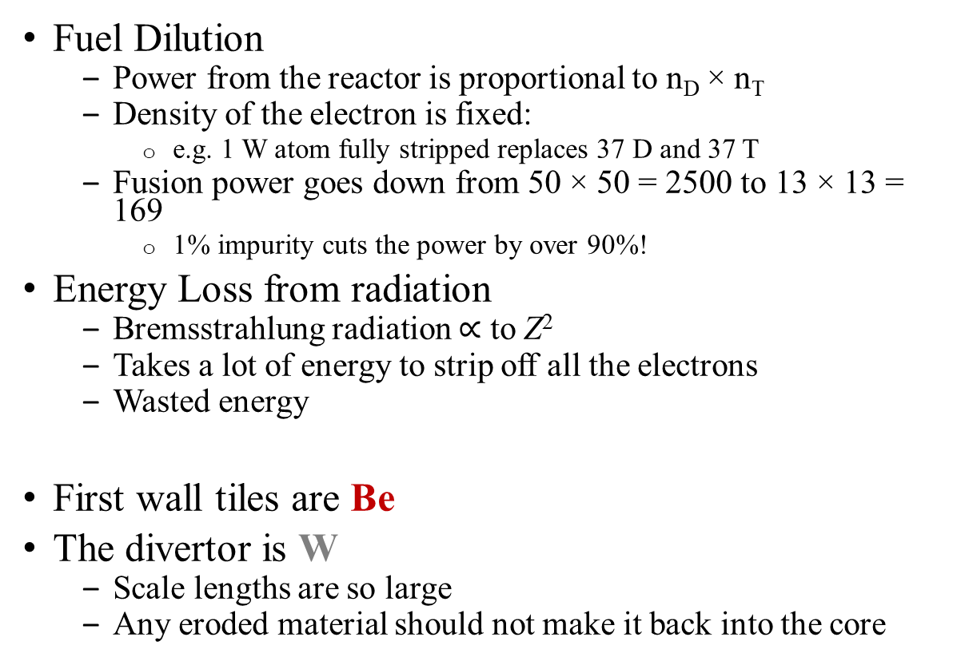
Maximum level of impurities allowed inside a reactor
Fuel Dilution
Power from the reactor is proportional to n_{D} × n_{T}
Density of the electron is fixed:
e.g. 1 W atom fully stripped replaces 37 D and 37 T
Fusion power goes down from 50 × 50 = 2500 to 13 × 13 = 169
1% impurity cuts the power by over 90%!
Energy Loss from radiation
Bremsstrahlung radiation $∝$ to Z²
Takes a lot of energy to strip off all the electrons
Wasted energy
First wall tiles are Be
The divertor is W
Scale lengths are so large
Any eroded material should not make it back into the core

Slide 56
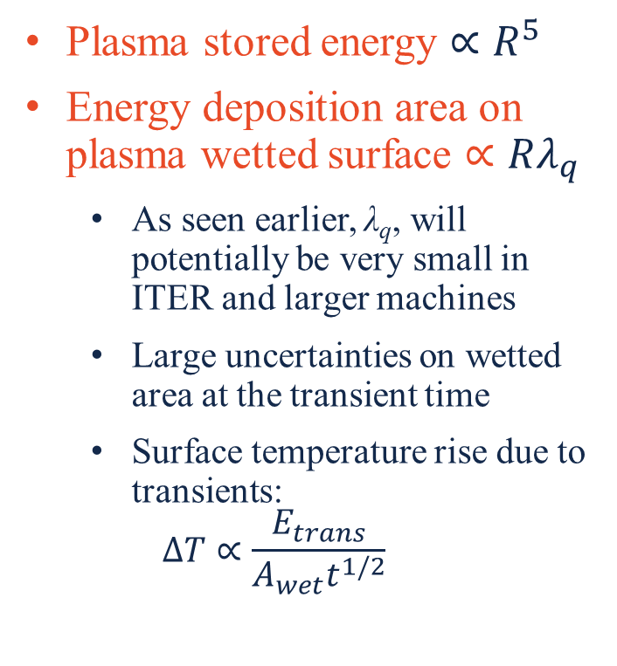
Heat flux limits - tungsten
Plasma stored energy $∝R^{5}$
Energy deposition area on plasma wetted surface $∝Rλ_{q}$
As seen earlier, λ_{q}, will potentially be very small in ITER and larger machines
Large uncertainties on wetted area at the transient time
Surface temperature rise due to transients:
$$∆T∝\frac{E_{trans}}{A_{wet}t^{1/2}}$$

Slide 57
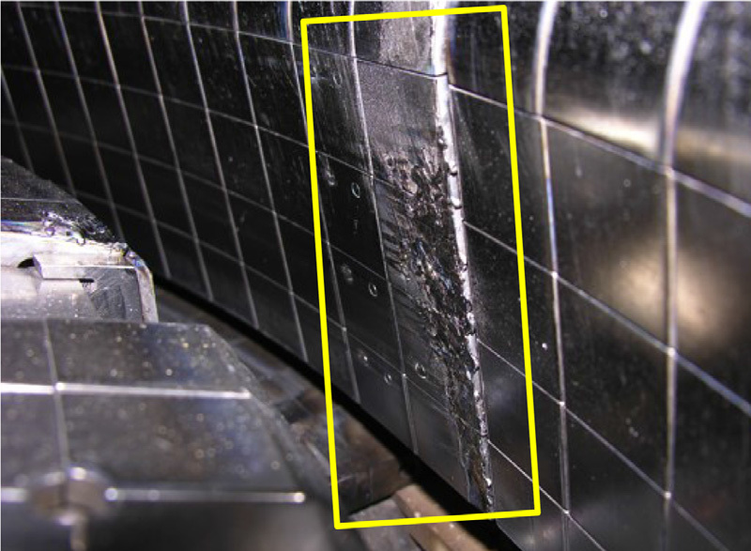
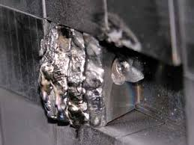
Heat flux is one of the most critical areas for future devices
Need to manage:
Stationary heat fluxes at the limit of cooling technology
Near complete mitigation of transients
Low tritium retention
High throughput fuel cycle
Material migration and erosion rates on a scale never seen before
Cracked, arced and melted tungsten
Like being in an arc-welder (heat flux 40 MW/m²)
Surface of the Sun, 63 MW/m²

Slide 58
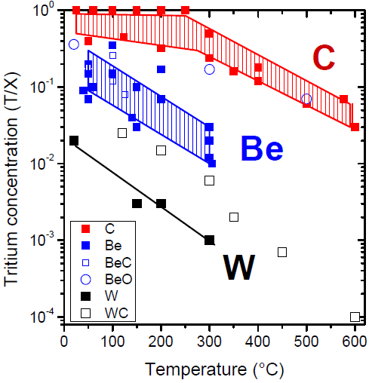
Tritium (fuel) retention at the surface and boundary
A 400 s Q_{DT} = 10 ITER discharge will require ~100 g of tritium fueling
Maximum in-vessel mobilisable T in ITER limited to 1kg
This is a safety issue
In practice, administrative limit of ~700 g
120 g in cryopumps
180 g uncertainty
Predicting the expected retention in ITER is fraught with uncertainty but progress is being made
For C, complex interplay between erosion → hydrocarbons → dissociation / ionization → transport → re-deposition → migration to remote areas with high sticking coefficients and retention in co-deposits
Carbon traps D, T very efficiently
D/C ratio can be in the range ~0.4 → > 1
For Be, co-deposition of T also possible - large potential source of Be from first wall
For W, most of retention will be from implantation → not thought to constitute a large reservoir
BUT effects of increased trapping due to neutron irradiation of metals – does not look like an issue from recent results

Slide 59
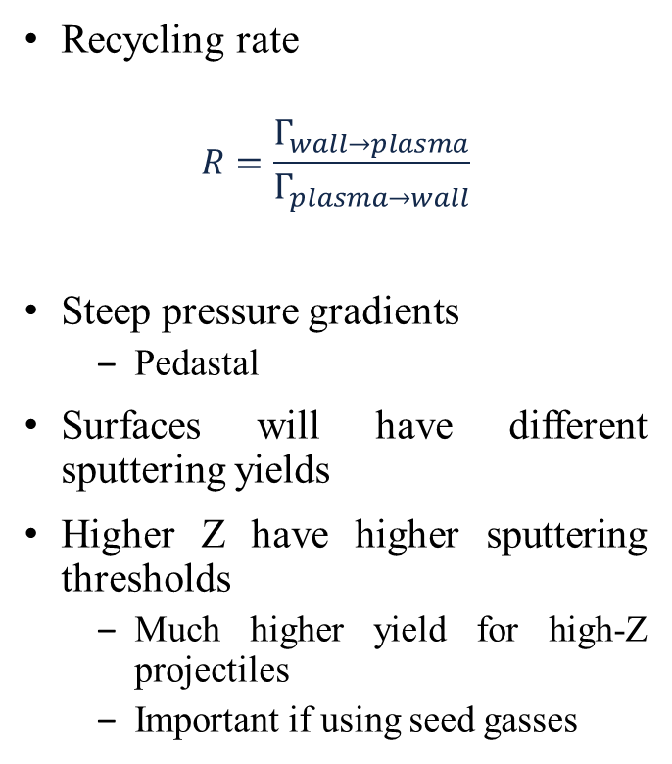
Cold and Neutral Atoms Coming off the Wall Surface will Interact with the Plasma
Recycling rate
$$R=\frac{Γ_{wall→plasma}}{Γ_{plasma→wall}}$$
Steep pressure gradients
Pedastal
Surfaces will have different sputtering yields
Higher Z have higher sputtering thresholds
Much higher yield for high-Z projectiles
Important if using seed gasses
Physical Sputtering
Chemical Sputtering
ITER Divertor flux
D impact

Slide 60
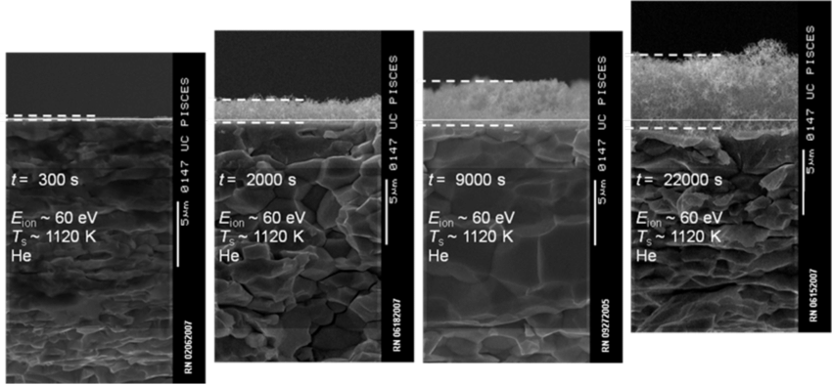
Surface modification can Lead to Dust and Safety Issues
Hydrogenic species can form blisters and bubbles on a surface
Tendril Growth/Fuzz with helium exposure
Seen not just on W but other metals as well
Erosion of the fuzz leading to impurities, causing large losses in fusion power.

Slide 61
Surface modification can Lead to Dust and Safety Issues
Expectation is that increase in duty cycle and erosion in ITER will lead to large scale-up in quantity of dust particles produced
Like T-retention, dust is a safety issue
dust particles radioactive (tritium + activated metals)
potentially toxic (Be)
potentially responsible for a large fraction of in-VV mobilisable tritium
chemically reactive with steam or air
Radiological or toxic hazard depends on how well dust is contained in accident scenarios and whether it is small enough to remain airborne and be respirable
size needs to be <~ 100 μm
depends on how dust is produced, e.g. crumbling of co-deposited layers or destruction (thermal overload) of tritiated layers during off-normal events
tritiated dust can levitate in electric fields as a result of self-charging due to emission of beta electrons

Slide 62
Remember the summary of all these interactions

Slide 63
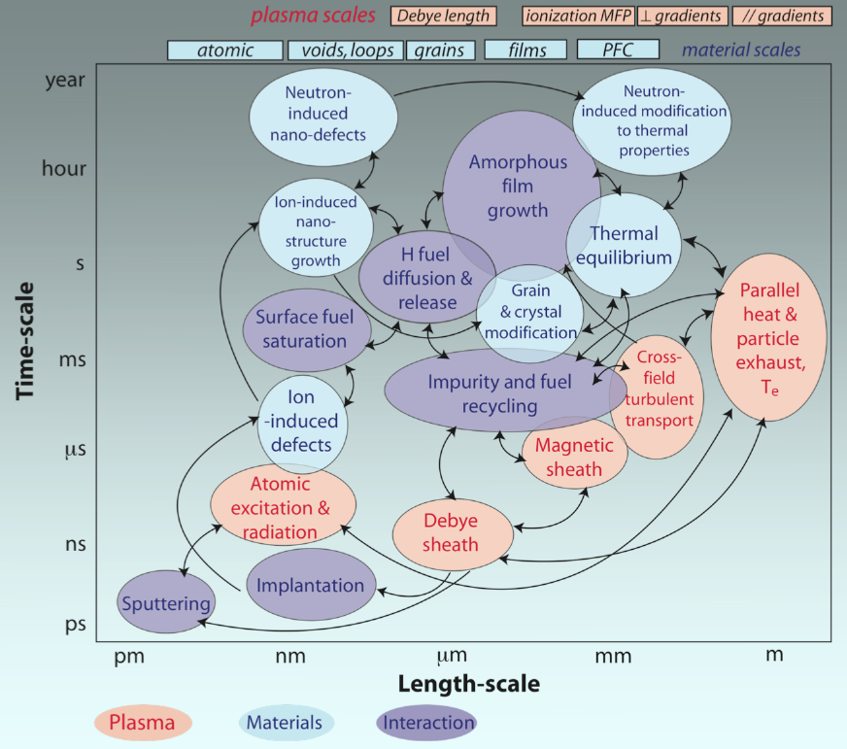
Time and temperature scale makes it even more complex

Slide 64

Unidentified flying objects (UFO)

Slide 65
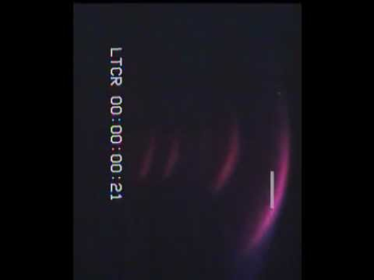
A failure in materials can have spectacular results!

Slide 66
Final note on neutron material interactions
³H
²H
Proton
Neutron
Positron
Neutrino
Gamma Ray
ν
γ
Total Energy 17.6 MeV
n
⁴He
14.1 MeV
3.5 MeV

Slide 67
Remember, neutrons will also change materials & surfaces
He/dpa ≤ 1 (fission); > 10 (fusion)
H/dpa = 10 (fission); > 40 (fusion)
n-damage in materials
Creates disorder
Vacancies
Transmutations
helium
Severity of damage measured by dpa (displacement per atom)
ITER ~1 dpa
DEMO 20-50 dpa
The D-T fuel reacts inside the fusion reactor
Neutrons that are produced from the fusion reaction are stopped in the blanket.
This heats it up and also generates tritium (breeding)
HOWEVER
Ferritic – Martensitic Steel Li – ceramic or LiPb (breeder)
This damage is studied in irradiation experiments in material testing reactors
Tungsten – Carbon – stainless steel – (Plasma facing components)
Tungsten armour - copper alloys (heat sink)
F. Maviglia ITER School talk, 2019

Slide 68
If the plasma is liquifying solid metals… lets start off with a liquid metal!
ELM’s, VDE’s and other instabilities will eventually turn any surface into a liquid metal
So why not start out with a liquid metal from the get go
Several options to look at:
Lithium
Tin
Gallium
Tin-Lithium

Slide 69
Complex behavior of materials – liquid metals
As low-Z as possible:
Minimise power losses by reducing high-Z impurities entering the core.
High affinity for ionised fuel species:
Mitigates instabilities and eliminates ELMs, Increases cross-sectional T_{i} while reducing particle wall flux.
Constantly refreshing:
Removes impurities and products (if flows outside chamber) + minimises erosion
Stable flow
Need to avoid any dry out or lack of wetting
Damage to the substructure
Neutron tolerant
Plasma
T_{e}(a,t)
T_{i}(a,t)
n_{e}(a,t)
n_{i}(a,t)
P(a,t)
β(a,t)
Liquid Lithium Wall
Ions
First Wall
Impurities
Neutrals
Heat Removal
Heat Removal
Other
Impurity removal
Fuel Retention

Slide 70
Liquid lithium has Become the more Studied Liquid Metal for Fusion
First evidence for lithium were the TFTR super shots in 1994!
Low Z
Tends to stay in the edge
Can be used for instability control
Not to say that it has its own issues and challenges

Slide 71
What Low recycling does for fusion – Lithium Wall Fusion (LiW)
No cold hydrogen returns from the wall – Plasma stays hot
Standard case
Lithium case:
The radius needed is only 1/3
Volume, and the cost of fusion power reduced
Factor ~ 27!
Plasma Physics and alpha heating get ion and electron temperature gradient turbulent transport for stability
Bad core and edge stability (sawteeth, ELMs etc…)
Most of the plasma volume does not produce fusion
Nothing from the physics expected or accepted
Stability is excellent, no instabilities, external control
The whole plasma volume produces fusion

Slide 72


Lithium coatings reduce the D recycling, reduces H-mode power threshold, broadens T_{e} profile, reduces electron thermal diffusivity, improves confinement and ELM Suppression
Increasing
Lithium
Up to 600 mg
– No Li
– Medium Li coating
– Thick Li coating

Slide 73
Outline
Introduction 3
Basics of plasma material interactions 7
Low temperature plasma material interactions 28
High temperature plasma material interactions 50
Plasma surface diagnostics 74
Summary 84

Slide 74
PMI experiment and theory
Ballistic
Diffusional
PSI Scales
10⁻¹⁵ 10⁻¹² 10⁻⁹ 10⁻⁶ 10⁻¹ to hr
Conventional surfcae sensitive techniques
Time
(sec)
Experimental
Capability
pump probe pulsed system
Molecular dynamics
Kinetic Monte Carlo
Continuum finite modeling
Ab-initio, QMD
Modeling capability
10⁻¹⁰ 10⁻⁷ 10⁻⁶ 10⁻² to 10⁻³
Spatial
(feature size, m)
Nano Probe Highly Focused
Conventional surface sensitive techniques
10⁻² 10¹ – 10² <10⁴ >10⁴
Thermal
Hyper-thermal
Low energy
High Energy
Energy (eV)

Slide 75

Plasma material interface diagnostics

Slide 76
Surface diagnostics
Scanning Electron Microscope (SEM)
Auger Electron Microscope (AEM)
X-ray Photon Spectroscopy (XPS)
Low Energy Ion Scattering Spectroscopy (LEISS) and Direct Recoil Spectroscopy (DRS)
Thermal Desorption Spectroscopy (TDS)
Laser Induced Breakdown Spectroscopy (LIBS)

Slide 77



Scanning electron microscope (SEM)
SEM is a type of electron microscope
Scans a focused beam of electrons over a surface
Electrons interact with atoms
Various signals produces that are detected
A topographical and compositional map of the surface is generated
Raster pattern used
Beam position with detected signal used to build up the image
Excellent resolution, better than 1 nm.
Left: Raster Pattern scans up and down the sample building up the image.
Bottom: SEM with an opened sample chamber

Slide 78


Auger electron spectroscopy (AES)
This is a surface sensitive analytical technique used to determine the elemental compositions of materials.
Can be used to potentially get the chemical state of surface atoms too.
The information depth for Auger analysis is the top 2-20 atomic layers.
When an atom is probed by a photon or electrons with energies of several eV → 50 keV
Core electron removed leaving behind a hole.
Unstable state, the core hole can filled by an outer shell electron
Electron moving to the lower energy level loses an amount of energy equal to the difference in orbital energies.
The transition energy coupled to a second outer shell electron
emitted from atom if the transferred energy is greater than the orbital binding energy.

Slide 79


X-ray photon spectroscopy (XPS)
XPS is a surface chemical analysis technique that can be used to analyze the surface chemistry of a material
As-received state, or after some treatment
for example: fracturing
cutting or scraping in air
UHV to expose the bulk chemistry
XPS is used to measure:
elemental composition of the surface (top 0–10 nm usually)
Empirical formula of pure materials
elements that contaminate a surface
chemical or electronic state of each element in the surface
uniformity of elemental composition across the top surface (or line profiling or mapping)
uniformity of elemental composition as a function of ion beam etching (or depth profiling)
E_{binding}, is the binding energy of the electron, E_{photon}, is the energy of the X-ray, E_{kinetic}, is the kinetic energy of the electron as measured and, ϕ, is the work function.

Slide 80


Low energy ion scattering spectroscopy (LEISS) and direct recoil spectroscopy (DRS)
Sometimes referred to as ion scattering spectroscopy (ISS),
Surface sensitive analytical technique
Characterises chemical and structural make up of a material
Directs a beam of ions at a surface
Makes observations of the ions that interact with the surface.
Can detect metal impurities and sputtered .
He, Ne, Ar typically used
Sensitive to first surface layer of a material
Under the right conditions
Direct Recoil Spectroscopy (DRS)
Sensitive to hydrogen and deuterium that is on the surface
The energy after a collision with a heavy atom is high (red) while with a light atom is low (green).

Slide 81

Thermal desorption spectroscopy (TDS)
Also known as temperature programmed desorption (TPD).
Observing of desorbed atoms/molecules from the surface when the temperature is increased.
Not really a spectroscopy technique hence why some like to use TPD.
When molecules or atoms come in contact with a surface the absorb onto it forming a bond with the surface.
Binding energy varies with the adsorbed molecule and surface combination.
Surface is heated, at a point, the energy transferred to the adsorbed species will cause it to desorb.
Temperature which happens is known as the desorption temperature.
TDS shows information on the binding energy.
Typically a RGA or a QMS or TOF mass spectrometer used to detect the adsorbed molecules/atoms.
RGA
Layer of adsorbed molecules
Desorbed molecule
surface
heater
C. H. Skinner, JNM 2011
TDS of ATJ graphite exposed via MAPP in NSTX. (a) without lithium and (b) with lithium.

Slide 82

Laser induced breakdown spectroscopy (LIBS)
Type of atomic emission spectroscopy.
Energetic laser pulse as the excitation source.
Focused to form a plasma
Atomizes and excites atoms/molecules from the surface.
In principle does not discriminate to the state of matter
Solid, liquid and gas
Can detect all elements
Limited by the power of the laser.
Destructive technique, however such a small amount used – minimal destruction.
Uses a focused laser beam from a high power pulsed Nd:YAG laser to produce a “plume” at the surface.
Temperature can reach around 5,000 – 20,000 K
Breaks down into atomic and ionic species
Excited state
Safer than portable X-ray fluorescence since no ionizing radiation.
Laser
Surface plasma
Spectrometer
Surface
Emitted light

Slide 83
Outline
Introduction 3
Basics of plasma material interactions 7
Low temperature plasma material interactions 28
High temperature plasma material interactions 50
Plasma surface diagnostics 74
Summary 84

Slide 84
Summary
The intimate play between plasma – material interactions is critical to the understanding how we can control material deposition
Low temperature / plasma processing – manufacture and surface modification
Fusion plasmas – Plasma control and survivability of plasma facing surfaces
Many mechanisms of particles from the plasma modify the surface and the plasma itself
Implantation
Reflection
Electron emission
Sputtering
Redeposition of material
Impurities
What is the influence of materials on the plasma itself?
Many of these question hang on understanding the surface morphology and how it modifies under plasma exposure
These are rich and important areas of work and research whether its for using plasma to manufacture a microchip or to finally have a fusion reactor work!

